Slide 1
Association Analysis: Basic Concepts and Algorithms Dr. Lov Kumar Assistant Professor, BITS Pilani, Hyderabad Campus

Slide 2
Association Rule Mining
Given a set of transactions, find rules that will predict the occurrence of an item based on the occurrences of other items in the transaction

Slide 3
Definition: Frequent Itemset
Itemset
A collection of one or more items
Example: {Milk, Bread, Diaper}
k-itemset
An itemset that contains k items
Support count (σ)
Frequency of occurrence of an itemset
E.g. σ({Milk, Bread,Diaper}) = 2
Support
Fraction of transactions that contain an itemset
E.g. s({Milk, Bread, Diaper}) = 2/5
Frequent Itemset
An itemset whose support is greater than or equal to a minsup threshold

Slide 4
Definition: Association Rule
Association Rule
An implication expression of the form X → Y, where X and Y are itemsets
Example: {Milk, Diaper} → {Beer}
Rule Evaluation Metrics
Support (s)
Fraction of transactions that contain both X and Y
Confidence (c)
Measures how often items in Y appear in transactions that contain X
Example:

Slide 5
Association Rule Mining Task
Given a set of transactions T, the goal of association rule mining is to find all rules having
support ≥ minsup threshold
confidence ≥ minconf threshold
Brute-force approach:
List all possible association rules
Compute the support and confidence for each rule
Prune rules that fail the minsup and minconf thresholds

Slide 6
Mining Association Rules
Example of Rules:
{Milk,Diaper} → {Beer} (s=0.4, c=0.67) {Milk,Beer} → {Diaper} (s=0.4, c=1.0)
{Diaper,Beer} → {Milk} (s=0.4, c=0.67)
{Beer} → {Milk,Diaper} (s=0.4, c=0.67) {Diaper} → {Milk,Beer} (s=0.4, c=0.5)
{Milk} → {Diaper,Beer} (s=0.4, c=0.5)
Observations:
All the above rules are binary partitions of the same itemset: {Milk, Diaper, Beer}
Rules originating from the same itemset have identical support but can have different confidence
Thus, we may decouple the support and confidence requirements

Slide 7
Mining Association Rules
Two-step approach:
Frequent Itemset Generation
Generate all itemsets whose support ≥ minsup
Rule Generation
Generate high confidence rules from each frequent itemset, where each rule is a binary partitioning of a frequent itemset
Frequent itemset generation is still computationally expensive

Slide 8
Frequent Itemset Generation
Given d items, there are 2^{d} possible candidate itemsets

Slide 9
Frequent Itemset Generation
Brute-force approach:
Count the support of each candidate by scanning the database
Match each transaction against every candidate
Complexity ~ O(NMw) => Expensive since M = 2d !!!

Slide 10
Frequent Itemset Generation Strategies
Reduce the number of candidates (M)
Complete search: M=2d
Use pruning techniques to reduce M
Reduce the number of transactions (N)
Reduce size of N as the size of itemset increases
Reduce the number of comparisons (NM)
Use efficient data structures to store the candidates or transactions
No need to match every candidate against every transaction

Slide 11
Reducing Number of Candidates
Apriori principle:
If an itemset is frequent, then all of its subsets must also be frequent
Apriori principle holds due to the following property of the support measure:
Support of an itemset never exceeds the support of its subsets

Slide 12
Illustrating Apriori Principle

Slide 13
Illustrating Apriori Principle
Pairs (2-itemsets)
(No need to generate candidates involving Coke or Eggs)
Minimum Support = 3
If every subset is considered,
⁶C₁ + ⁶C₂ + ⁶C₃ = 41
With support-based pruning,
6 + 6 + 1 = 13

Slide 14
Apriori Algorithm
Method:
Let k=1
Generate frequent itemsets of length 1
Repeat until no new frequent itemsets are identified
Generate length (k+1) candidate itemsets from length k frequent itemsets
Prune candidate itemsets containing subsets of length k that are infrequent
Count the support of each candidate by scanning the DB
Eliminate candidates that are infrequent, leaving only those that are frequent

Slide 15
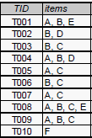

Slide 16
Bayes Classifier
A probabilistic framework for solving classification problems
Conditional Probability:
Bayes theorem:

Slide 17
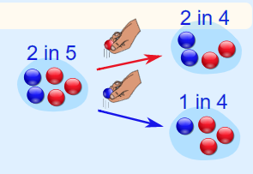
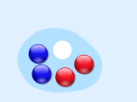

Example: Marbles in a Bag
Dependent Events

Slide 18
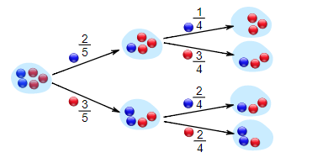

Slide 19
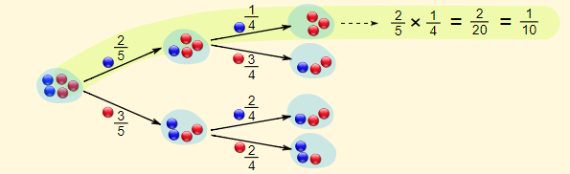
What are the chances of drawing 2 blue marbles?

Slide 20
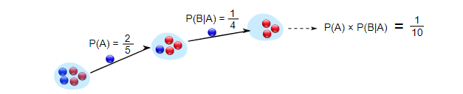
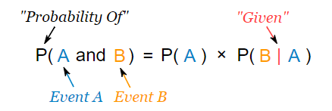

Notation
P(A) means "Probability Of Event A“
P(B|A) means "Event B given Event A“
Or event A has already happened, now what is the chance of event B?
P(B|A) is also called the "Conditional Probability" of B given A.

Slide 21
Bayesian Classifiers
Consider each attribute and class label as random variables
Given a record with attributes (A1, A2,…,An)
Goal is to predict class C
Specifically, we want to find the value of C that maximizes P(C| A1, A2,…,An )
Can we estimate P(C| A1, A2,…,An ) directly from data?

Slide 22
Approach:
compute the posterior probability P(C | A1, A2, …, An) for all values of C using the Bayes theorem
Choose value of C that maximizes P(C | A₁, A₂, …, A_{n})
Equivalent to choosing value of C that maximizes P(A₁, A₂, …, A_{n}|C) P(C)
How to estimate P(A1, A2, …, An | C )?

Slide 23
Assume independence among attributes Ai when class is given:
P(A1, A2, …, An |C) = P(A1| Cj) P(A2| Cj)… P(An| Cj)
Estimate P(Ai| Cj) for all Ai and Cj.
New point is classified to C_{j} if P(C_{j}) Π P(A_{i}| C_{j}) is maximal.

Slide 25
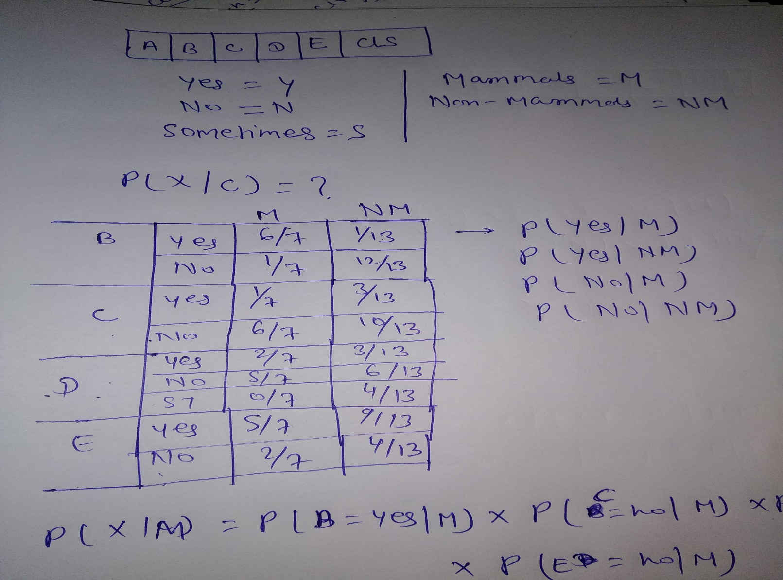

Slide 26
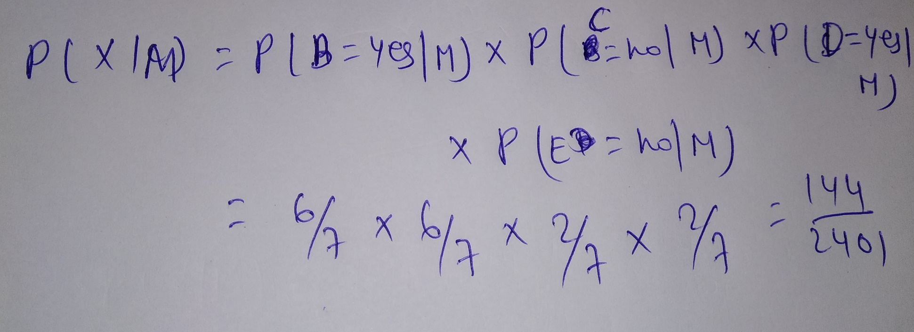

Slide 27
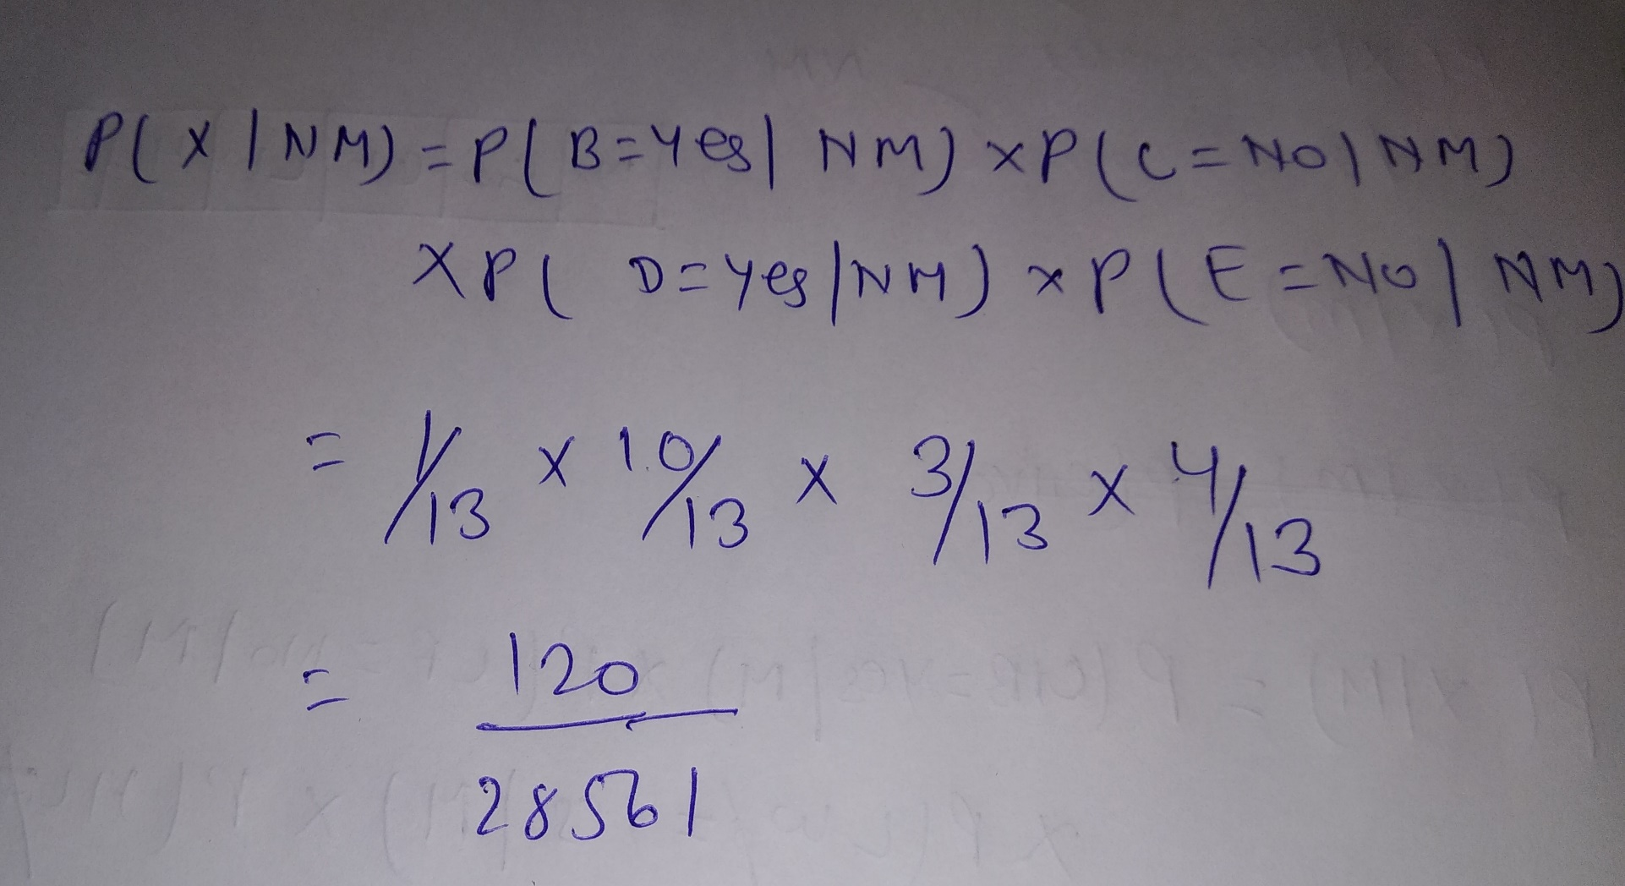

Slide 28
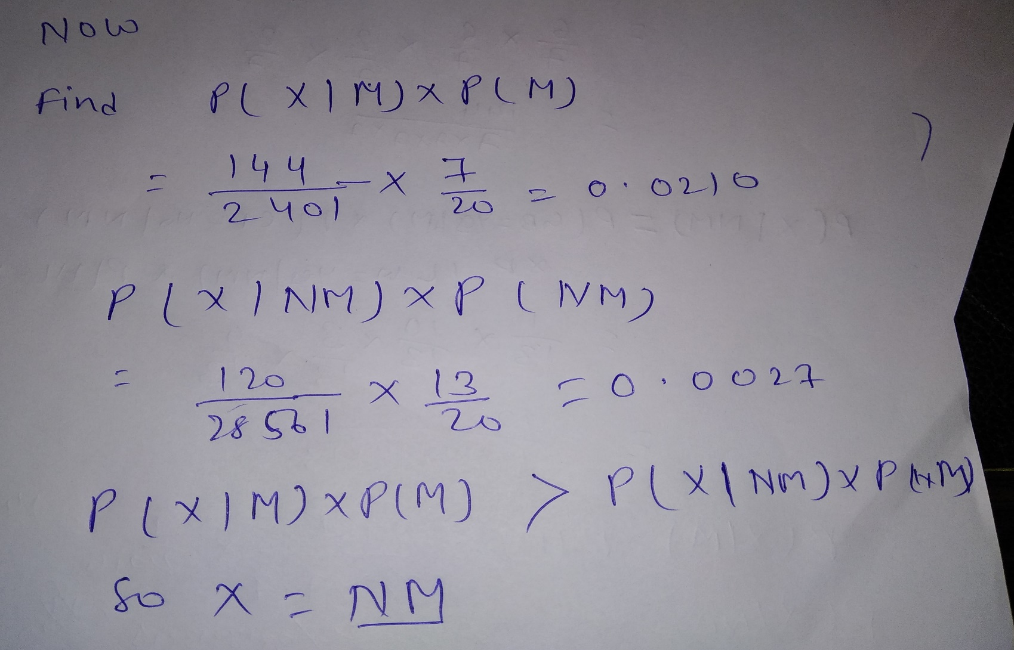

Slide 29
Artificial Neural Networks (ANN)

Slide 32
Initialize the weights (w0, w1, …, wk)
Adjust the weights in such a way that the output of ANN is consistent with class labels of training examples
Objective function:
Find the weights wi’s that minimize the above objective function

Slide 33
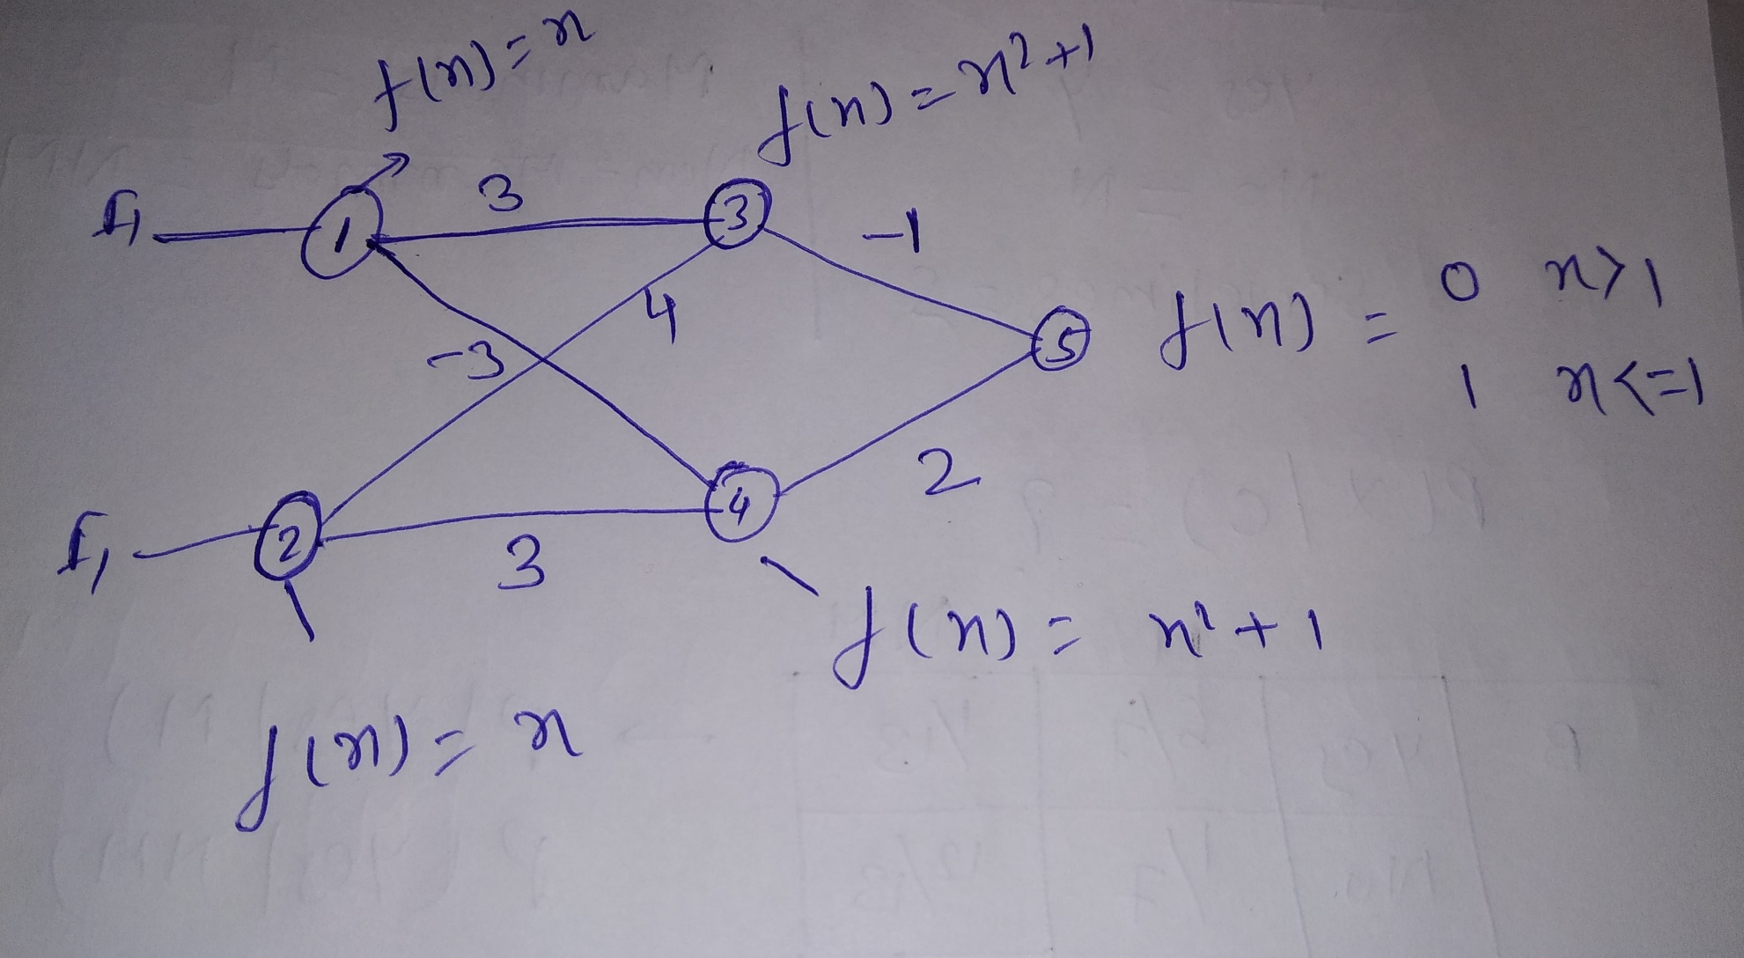

Slide 34
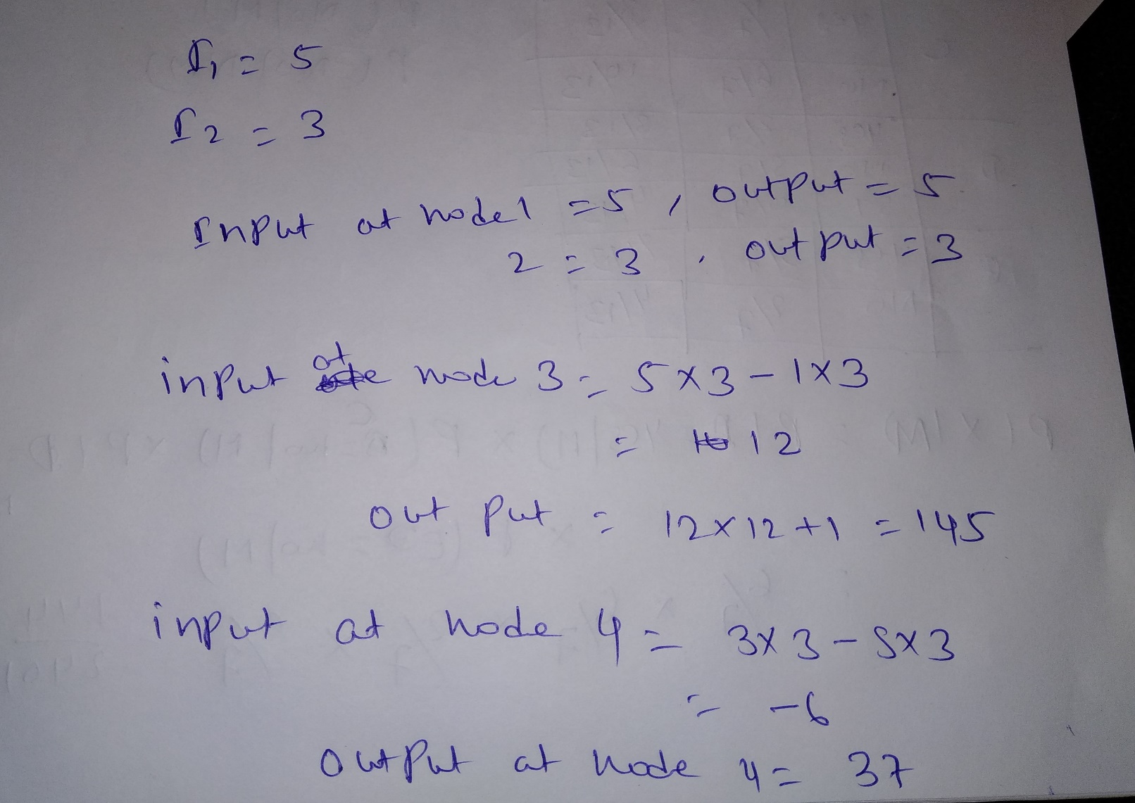

Slide 35
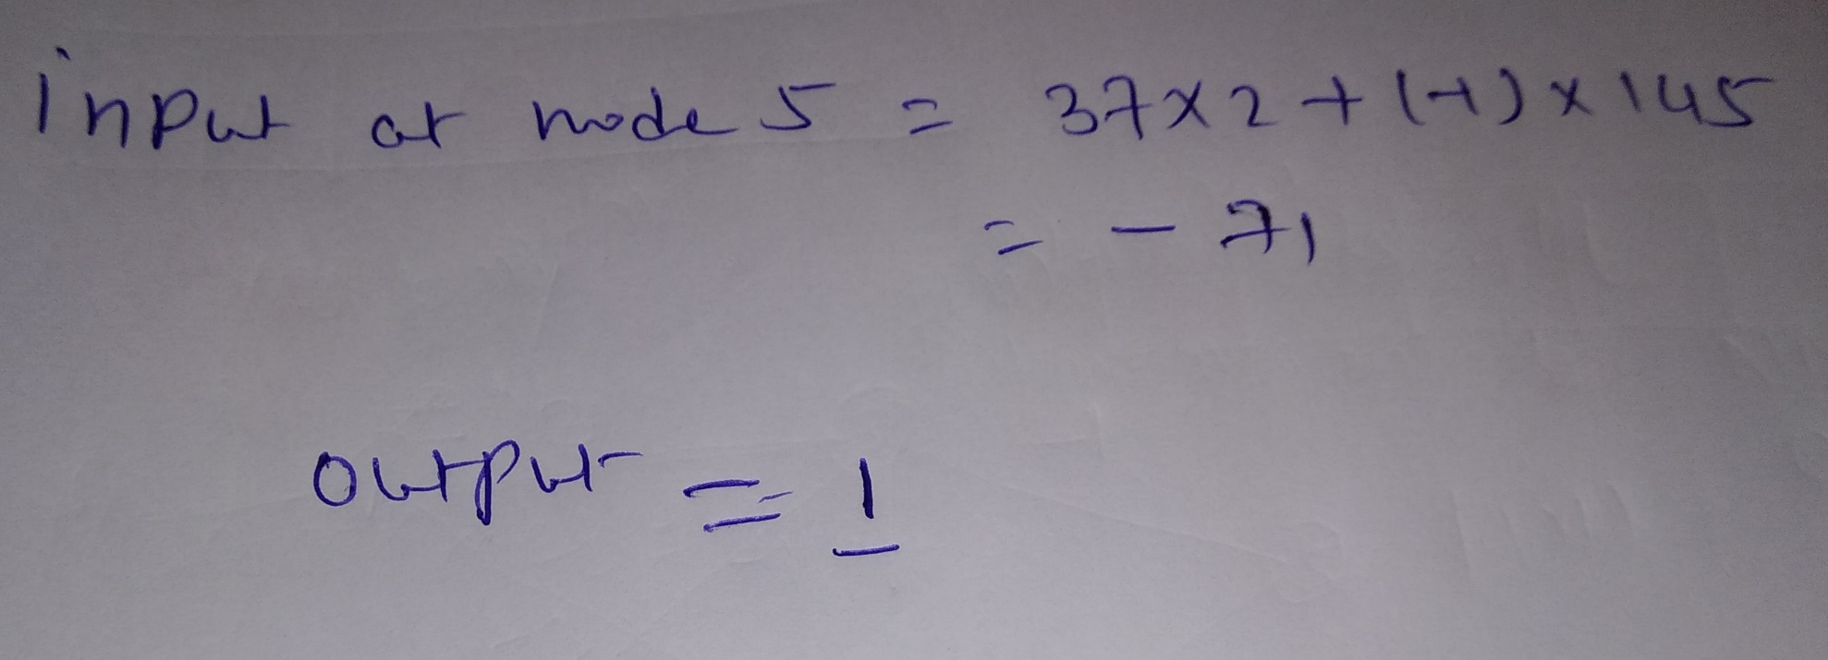

Slide 36
